Slide 1
Bad Addresses
County of San Diego

Slide 2
With this report:
You Will identify all the addresses that have been entered in the demographics. The good and the bad.
You will be able to correct any bad addresses that will potentially cause an error in billing.

Slide 3
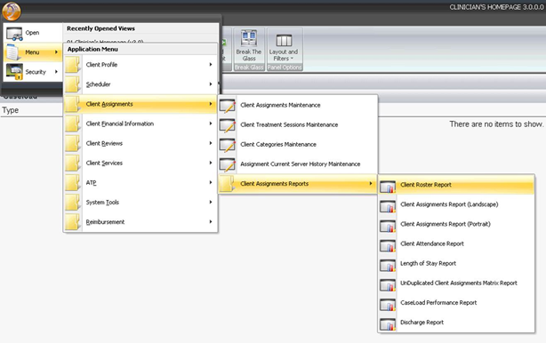
How do I run it

Slide 4
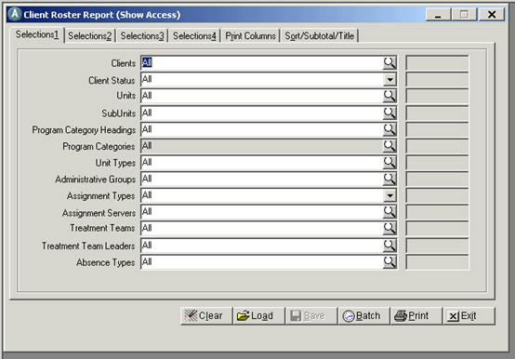
Click on the load button.

Slide 5
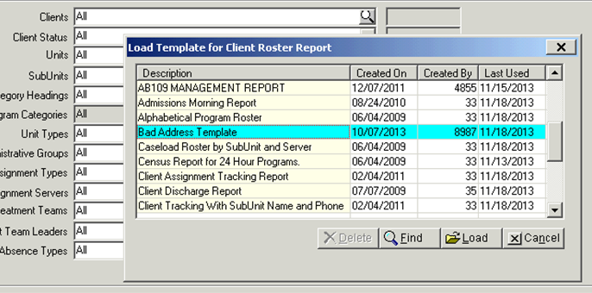
Bad Address Template
Select you’re the template and click on Load

Slide 6
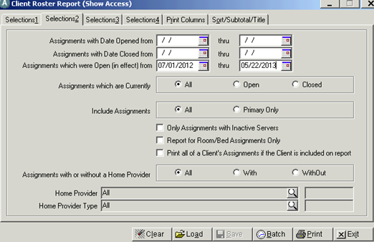
Tab 2. Set your date range
I find that its good to run this report for the Fiscal Year (i.e. 07/01/2013- current date) we are currently billing. but probably going as far as 14 months back wouldn’t hurt.

Slide 7
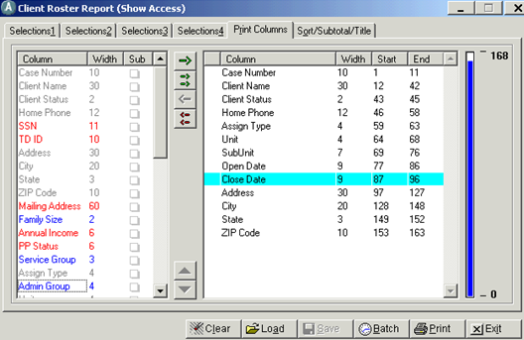
Print Columns Tab

Slide 8
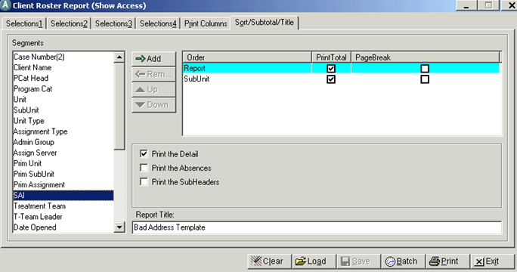
Sort/Subtotal/Title
You can modify the name on the report or simply click on print.

Slide 9
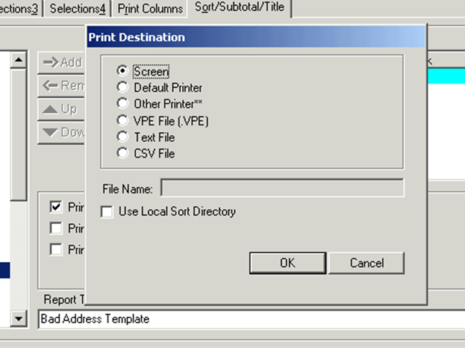
Print- OK

